Slide 1
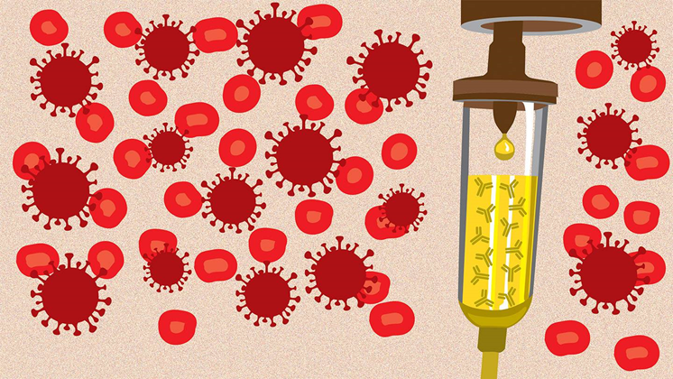
Medical Management of COVID-19
Akan Otu MB.BCh, DTM&H, MPH, MRCP, FWACP
Department of Infection and Travel Medicine
Leeds Teaching Hospital NHS Trust, Leeds UK

Slide 2


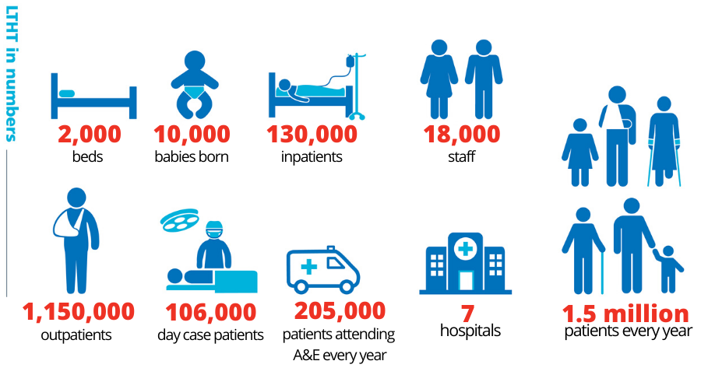

One of the largest and busiest acute hospital trusts in the UK

Slide 3
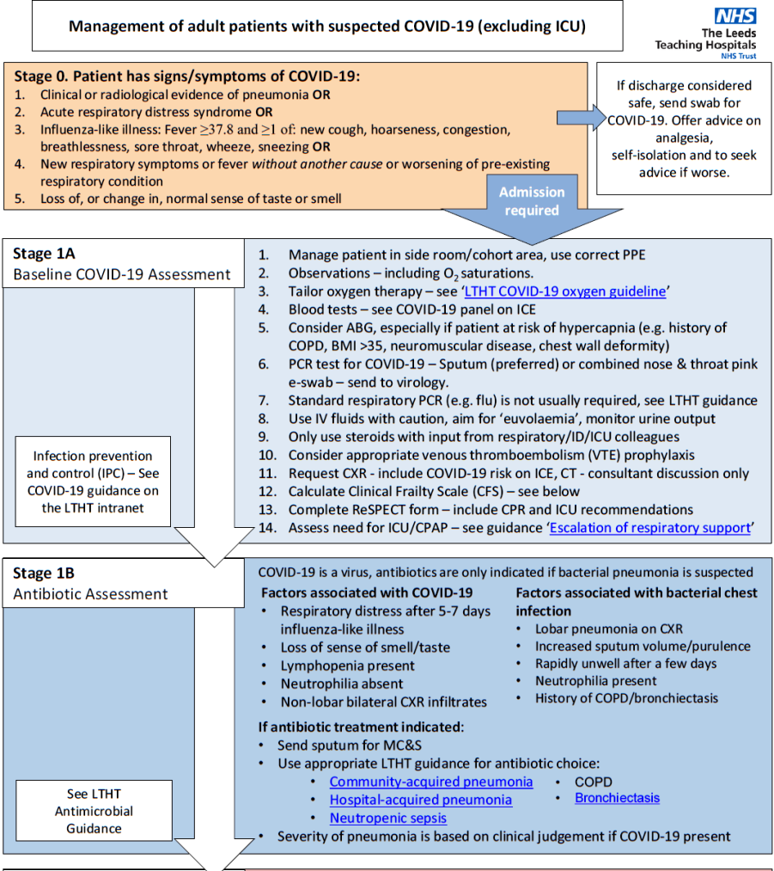

Slide 4
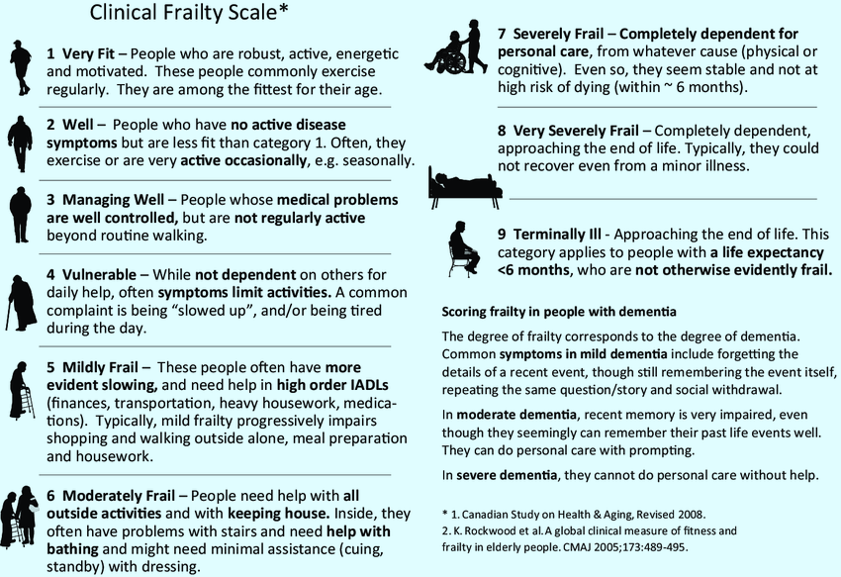

Slide 5
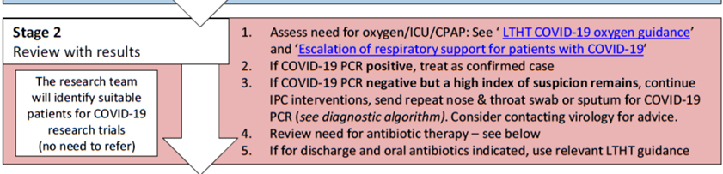
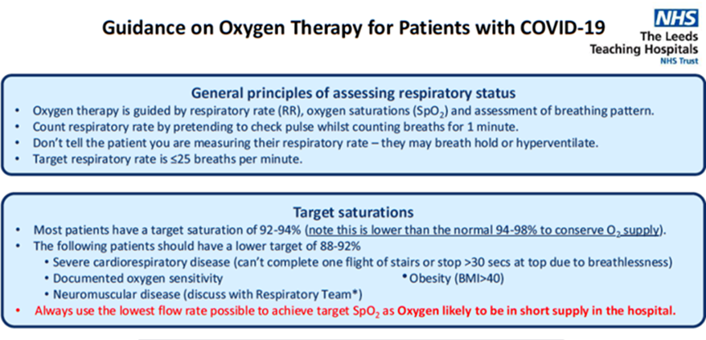

Slide 6
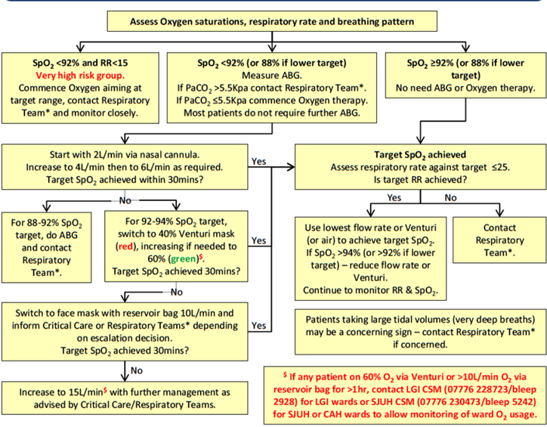
Notes:
Aerosol Generating Procedures (AGPs)
The PPE for AGPs has not changed: FFP3 mask, long sleeved gown, gloves and eye protection.
AGP PPE is required for entering a high risk clinical area (e.g. ICU) and when delivering AGPs in any
setting. Resuscitation rooms in ED and wards in which NIV/CPAP is performed are now defined as
high risk clinical areas.
The AGPs that could take place in a ward area are:
• Cardio- pulmonary resuscitation (CPR)
• Tracheal intubation (highest risk)
• Open suctioning/induction of sputum
• Non-invasive ventilation (NIV) or CPAP – including home NIV/CPAP
• HFNOT (‘Airvo’)

Slide 7
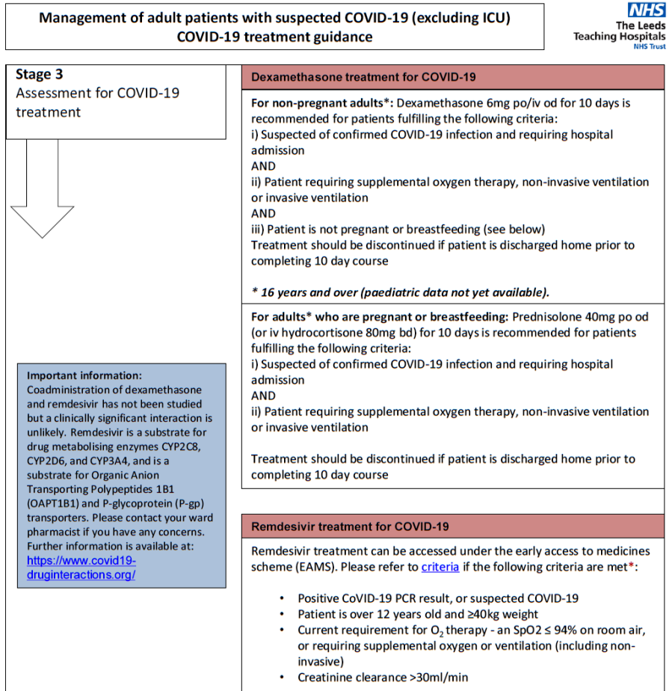

Slide 8
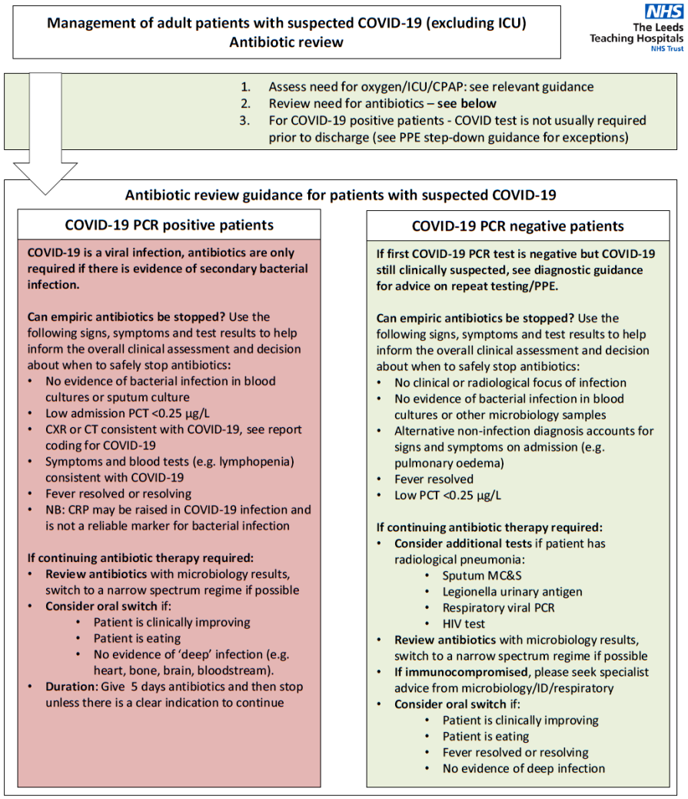

Slide 9
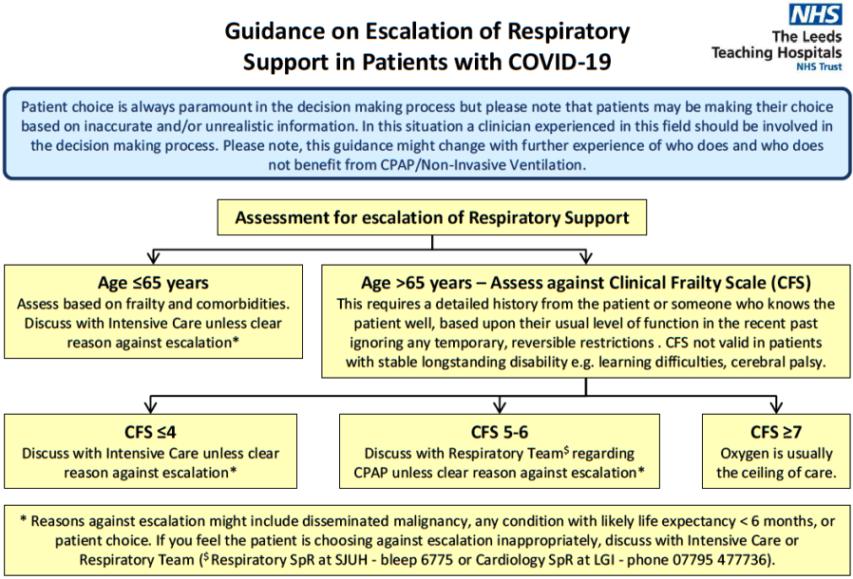

Slide 10
Other issues
Prevention of complications in hospitalized and critically ill patients with COVID-19
  Thromboembolism
  Adverse effects of other medications
Noncommunicable diseases and COVID-19
Treatment of other acute and chronic infections
Management of neurological and mental manifestations associated with COVID-19
Rehabilitation for patients with COVID-19
Palliative care
Notes:
COVID-19 is a novel disease, the rehabilitation needs for patients recovering from COVID-19 are anticipated based on evidence from the general critical care population. Based on this evidence, it is expected that acute interventions for the management of patients with severe and critical COVID-19, including mechanical ventilation, sedation and/or prolonged bed rest, may result in a range of impairments including (but not limited to) physical deconditioning, respiratory, swallow, cognitive and mental health impairments (145, 158-168). These symptoms are collectively referred to as post-intensive care syndrome (PICS) (169). Older people and patients of all ages with chronic diseases, may be most susceptible to its impacts (170-173). Patients recovering from severe COVID-19 who did not require admission to an ICU may also experience some degree of these symptoms (174).
For the following patient groups, routinely assess for mobility, functional, swallow, cognitive impairments and mental health concerns, and, based on that assessment, determine discharge readiness, and rehabilitation and follow-up requirements:
• patients that are in or have been discharged from intensive care;
• older patients that have experienced severe cases; and
Pre-existing NCDs, including cardiovascular disease, diabetes, chronic respiratory disease, hypertension and cancer, have been identified as independent risk factors for death (18).
We recommend when caring for patients with suspected and confirmed COVID-19 that have underlying NCDs to continue or modify previous medical therapy according to the patient’s clinical condition.
Management of neurological and mental manifestations associated with COVID-19
People with COVID-19 are at high risk for delirium, and sometimes delirium may be a presenting feature without respiratory symptoms (see Chapter 3). Anxiety and depressive symptoms may constitute common reactions for people in the context of COVID-19 diagnosis,

Slide 11
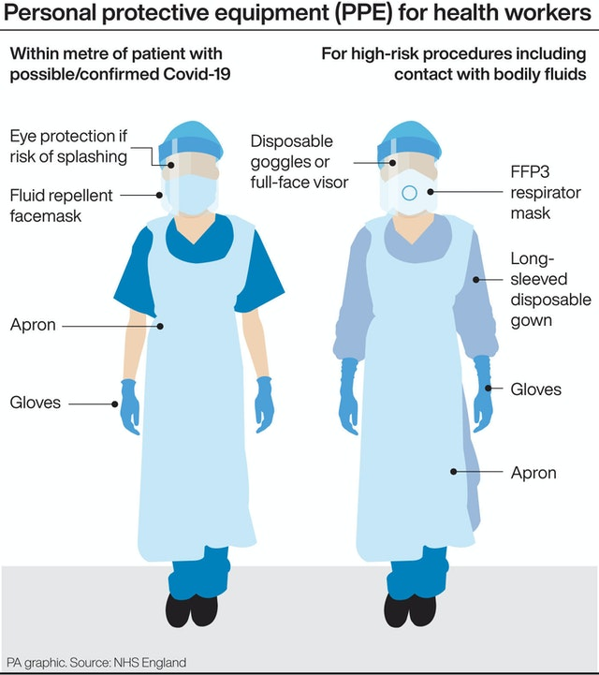
How to practice safely in Covid times
Minimize chance for exposure
Adhere to precautions
Manage visitor access and movement
Implement engineering controls
Implement environmental infection control
Establish reporting to public health authorities
Monitor and manage health personnel
Train and educate health professionals
Notes:
Marathon and not a sprint
Minimize chance for exposure
It is important to ensure facility policies and practices are in place to minimize exposure to respiratory pathogens including 2019-nCoV. These measures should be implemented before patient arrival, upon arrival and throughout the duration of the affected patient’s time in the health care setting.
Adhere to precautions
Follow standard precautions, the CDC says, to assume “every person is potentially infected or colonized with a pathogen that could be transmitted in the health care setting.”
It is important to pay attention to training on correct use, proper “donning and doffing,” and disposal of personal protection equipment. All health professionals who enter the room of a patient with known or suspected COVID-19 should adhere to standard, contact, and airborne precautions, including the use of eye protection.
Minimize chance for exposure
It is important to ensure facility policies and practices are in place to minimize exposure to respiratory pathogens including 2019-nCoV. These measures should be implemented before patient arrival, upon arrival and throughout the duration of the affected patient’s time in the health care setting.
Implement environmental infection control
Use dedicated medical equipment for patient care. Clean and disinfect all nondedicated, nondisposable medical equipment according to the manufacturer’s instructions and facility policies. Detailed information can be found in CDC’s guidelines for environmental infection control.
Monitor and manage health personnel
For physicians and other health professionals who are ill or exposed to 2019-nCoV, movement and monitoring decisions should be made with guidance from public health authorities. When providing care to patients with COVID-19, health care organizations and facilities should implement sick leave policies that are nonpunitive, flexible and consistent with public health guidance.
Train and educate health professionals
Everyone should be provided with job- or task-specific education and training on preventing transmission of infectious agents prior to caring for a patient. Whenever respirators are required, all health professionals must be medically cleared, trained and fit-tested for respiratory protection device use.
Implement environmental infection control
Use dedicated medical equipment for patient care. Clean and disinfect all nondedicated, nondisposable medical equipment according to the manufacturer’s instructions and facility policies. Detailed information can be found in CDC’s guidelines for environmental infection control.
Establish reporting to public health authorities
Implement mechanisms and policies that will help to promptly alert all appropriate members of the team, such as infection control or facility leadership, about a known or suspected COVID-19 patient.
You should also continue to communicate and collaborate with public health authorities. Specific persons within the health care organization should be designated for communication with public health officials and dissemination of information to health professionals.
The CDC’s guidance will be updated as more information becomes available and as the response to needs changes in the U.S.

Slide 12

