Slide 1
No Financial Conflicts of Interest
Diagnostic Challenges in COVID-19
P2P and ANADACH
Abiy B. Ambaye, MD
Clinical Professor
University of Vermont College of Medicine

Slide 2
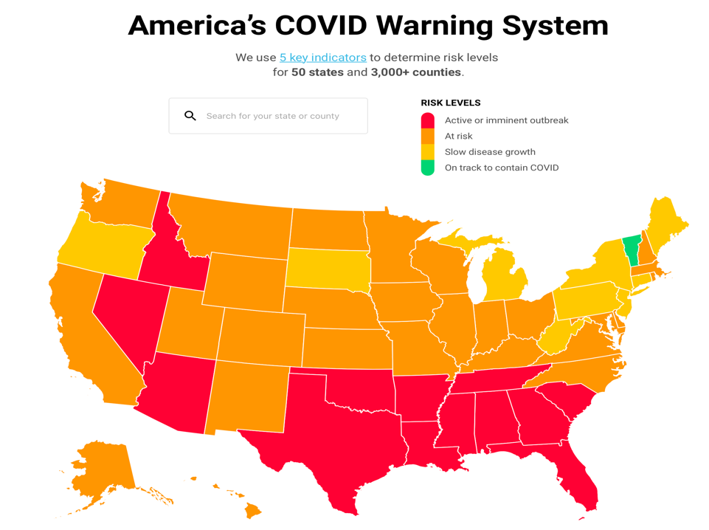
Vermont

Slide 3
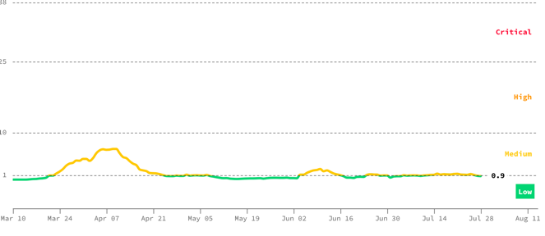
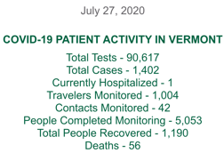
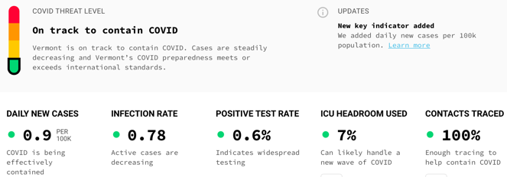
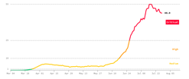
Vermont (pop 620K)
Florida

Slide 4
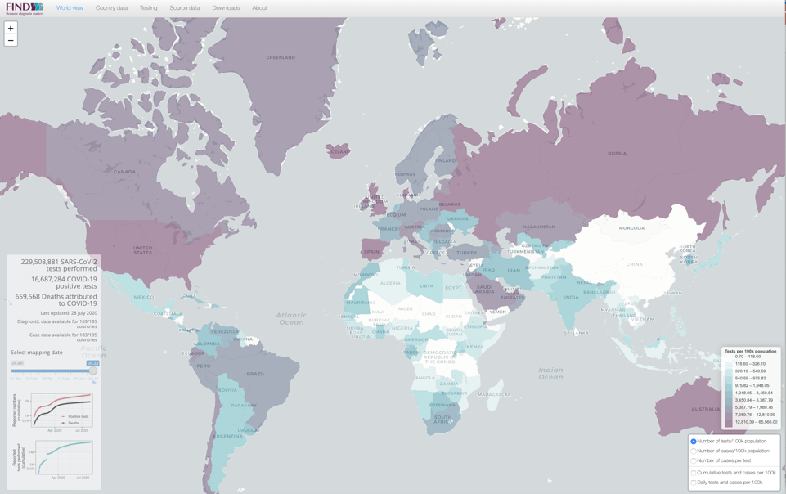
Number of Tests per 100K Population Worldwide

Slide 5
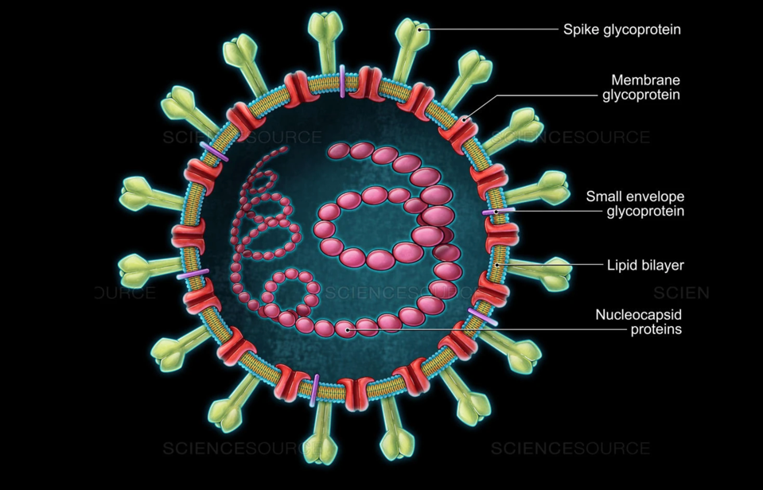
SARS-COV-2 Targets for Testing
Notes:
Nucleocapsid: The genome + the protein coat of the virus (capsid)

Slide 6
Levels of SARS-CoV-2 RNA, Antigen, and Antibody (IgM, IgG) after infection
??
http://www.diazyme.com/covid-19-antibody-tests
Antigen Test

Slide 7
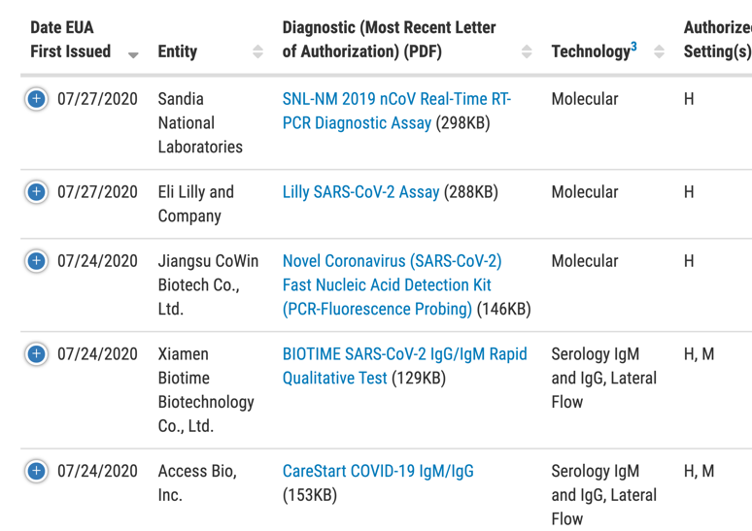
FDA Emergency Use Authorization (EUA)
FDA EUA (July 27. 2020)*
103 Molecular/PCR
33 Serology
2 Antigen
* Currently are no FDA-approved tests
https://www.fda.gov/medical-devices/emergency-situations-medical-devices/emergency-use-authorizations#covid19ivd

Slide 8
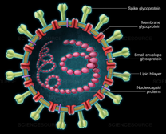
Molecular (RT-PCR) Test
Gold standard, more accurate and reliable
But it is:
Complex and highly centralized test
Expensive
Difficult to access by low and middle income countries (LMICs)
Does not meet current demand worldwide
~500 million tests needed in LMICs over the next year
Rapid Diagnostic Tests (RDTs) can fill this gap
Notes:
75% of which in decentralized settings (i.e. primary healthcare, community-level care, hospital triage)
high-performing, affordable, rapid diagnostic testing is available to everyone

Slide 9
Rapid Diagnostic Tests (RDTs)
Antigen Test
Antibody Test

Slide 10
Rapid Diagnostic Tests (RDTs)
Advantages:
Easy to perform, faster results (minutes)
Decentralized and portable
Cheaper
Disadvantages:
Lower Sensitivity (increased false negative rate)
Sensitivity: from <50% to >96%
Comparable specificity to molecular tests

Slide 11
Antigen RDTs
For detection of active infection (similar to molecular)
More likely to be affordable (Target price $1/test)
Should meet performance requirements:
High specificity (>97) and sensitivity (>80%)
Increase manufacturing capacity in HIC & LMIC
Available in a decentralized setting after short training
Easy sample collection* without cold storage requirement
* preferably self-collection: saliva, or nasal swab
Easy to use procedures and results interpreted visually
Notes:
Products must meet Target product profiles (TPP): not set yet for Antigen RDTs

Slide 13
US FDA granted EUA 2 Antigen RDTs many more on the WHO website

Slide 14
BD (Becton Dickinson) Veritor System for RDT Antigen Detection of SARS-CoV-2
Notes:
Approved for EUA on July 2. 2020

Slide 15
BD Veritor System for Antigen RDT
Qualitative detection of nucleocapsid antigens
Nasal swabs - first 5 days of symptom onset
Positive results: use for management
High specificity
Negative results:
Only presumptive - does not rule out infection
Not be used as the sole basis for management
Re-test with molecular
If still suspected (exposure history & clinical findings)
Notes:
use of product:
nasal swab specimen is directly placed in the extraction reagent tube, during which time virus particles present in the specimen are disrupted, exposing internal viral nucleoproteins
After that, the specimen is added to the BD Veritor System test device
SARS-CoV-2 antigens present in the specimen then bind to antibodies conjugated to detector particles in the test strip
The antigen-conjugate complexes migrate across the test strip to the reaction area and are captured by a line of antibodies bound on the membrane
Test results are read when the 15-minute assay development time is complete
SARS-CoV-2 (+) Control Swab:
swab is coated with non-infectious recombinant SARS antigens
The positive control is used to monitor for failures of test cassette reagents and reaction conditions
SARS-CoV-2 (–) Control Swab:
swab is dried with buffer solution and preservative, in the same formulation as the positive control without the signal protein.

Slide 16
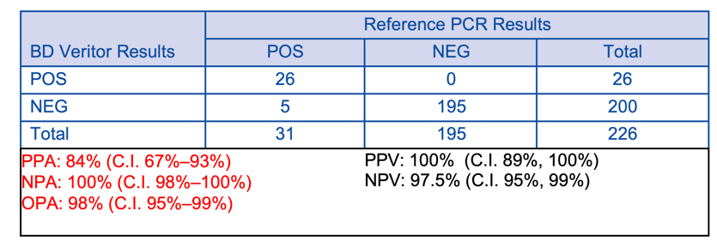
Performance BD Veritor System Antigen vs. Molecular
226 nasal swabs from symptomatic patients (within 5 days of onset)
Antigen RDT compared to results of molecular (RT-PCR) test
Sensitivity = 84%
Specificity = 100%
Notes:
CLINICAL PERFORMANCE:
226 direct nasal swabs prospectively collected and enrolled from individual symptomatic patients (within 5 days of onset) who were suspected of COVID-19
As with all antigen tests, performance has been demonstrated to decrease as days since symptom onset increases
Nasal swabs were collected following the dual nares method
Specimens were frozen within 30 minutes of collection and stored until tested
The performance of the BD Veritor System Assay was compared to results of a nasopharyngeal or oropharyngeal molecular (RT-PCR) test

Slide 17
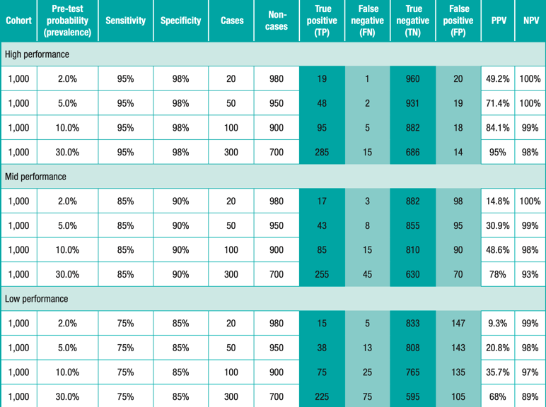
Performance of RDTs in high & low prevalence COVID-19 infection
Notes:
as seen below, a test with high performance (95%sensitivity and 98% specificity), when applied to a low- prevalence setting, will result in roughly the same number of true positives and false positives (PPV: ~50%),
whereas when applied to a higher prevalence population would result in a much higher positive predictive value (PPV: 95%), with the majority of positive results associated with actual cases. Alternatively,

Slide 18
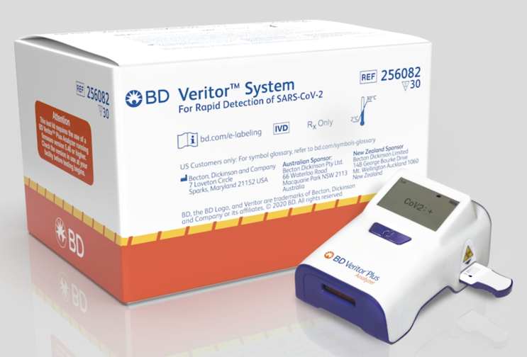
Antigen RDT (High performance: sens 95% and specif 98%)
1000 people with COVID-19 symptoms in Addis Ababa
If prevalence of COVID-19 in Addis Ababa is:
2% (PPV= 49.2%) 30% (PPV= 95%)
19 True positive
20 false positive
960 True negative
1 false negative
285 True positive
14 false positive
686 True negative
15 false negative
Notes:
Remember: performance decreases as time from symptoms increases (more than 5 days)

Slide 20
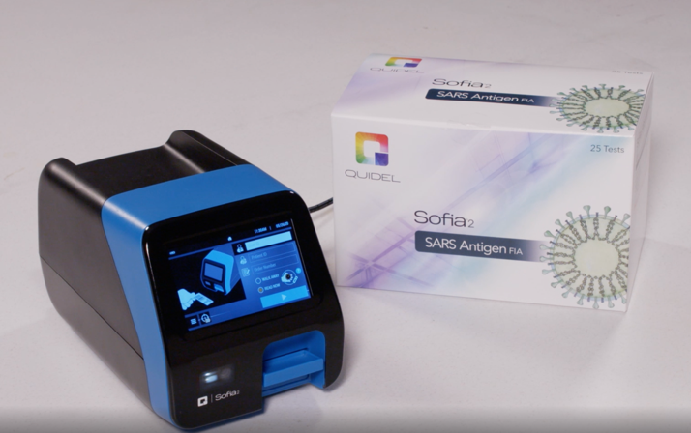
Sofia SARS Antigen FIA
209 direct nasal swabs from symptomatic patients
The Antigen RDT compared to molecular (RT-PCR) test
Sensitivity = 96.7%
Specificity = 100%
Notes:
qualitative detection of the nucleocapsid protein antigen from SARSCoV-2 in nasopharyngeal (NP) and nasal (NS) swab specimens directly or after the swabs have been added to viral transport media from individuals who are suspected of COVID-19 by their healthcare provider
First FDA authorized (EUA) antigen test
Detects fragments of proteins on or in the virus
Samples from the nasal cavity using swabs
Authorized for use in high/moderate complexity labs and point-of-care (POC) testing
Sensitivity = 96.7% (95% CI = 37.6-96.4)
Specificity = 100% (95% CI = 91.8-100)
CLINICAL PERFORMANCE:
209 direct nasal swabs was performed
sequentially enrolled from symptomatic patients suspected of COVID-19 at five (5) locations
tested fresh at a single central laboratory
All patients had either a NP swab (for RT-PCR testing) and nasal swab (for Sofia testing) or matched nasal swabs collected for RT-PCR and Sofia testing
The Sofia SARS Antigen FIA was compared to the a Reference Extracted RT-PCR assay

Slide 21
ACT Accelerator Initiative

Slide 22
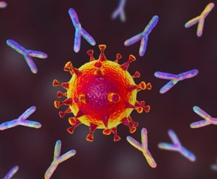
Serology (Antibody Testing)
Response to different targets in the virus:
Anti-Spike (S) protein
More specific
Used for viral entry into host cell
Needed for protection (neutralizing)
Anti-Nucleocapsid (N) Protein
Less specific
Highly immunogenic and abundant
Most available tests detect this protein

Slide 23
Levels of SARS-CoV-2 RNA, Antigen & Antibody after infection
??
http://www.diazyme.com/covid-19-antibody-tests

Slide 24
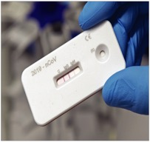
Serology (Antibody Test)
Host/patient response to infection
At least 10 days after infection
Can not distinguish between active and previous infection
Currently: can't confirm immunity to reinfection
aka Immunity Passport
More accurately estimates prior:
Infection Rate
Case Fatality Rate Incidence
Prevalence
FDA EUA requires:
90% sensitivity
95% specificity

Slide 25
Serology - Utility
Screening previous exposure – beneficial
Public health planning – case fatality rate (COVID-19 resurgence)
Returning to work (aka Immunity Passport)?
Protective effect and durability not yet determined
Screening currently infected patients – not beneficial
In low prevalence of infection (very low PPV)
Recent FDA warning regarding fraudulent claims
Convalescent Serum: treatment of severely ill patients?

Slide 26
Thank You
“in a pandemic, no one is safe until everyone is safe”

