Slide 1
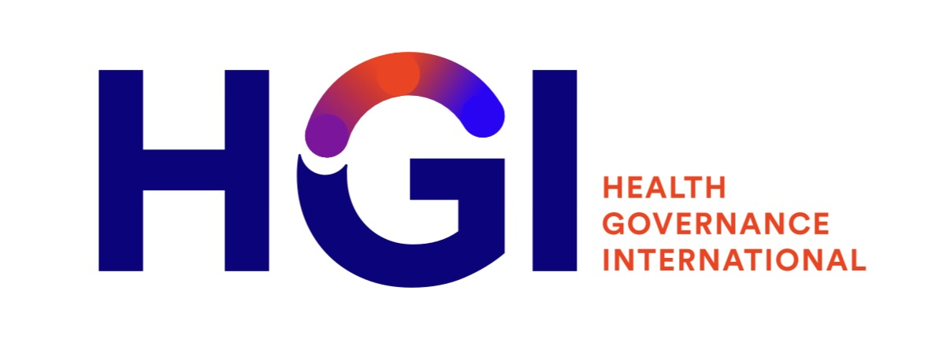
Webinar on Governance of African Pharmaceutical Value Chain
“The chain is only as strong as its weakest link”
Thomas Reid’s
© This content is copyright of Health Governance Intenratinoal LLC and not to be used without prior approval

Slide 2
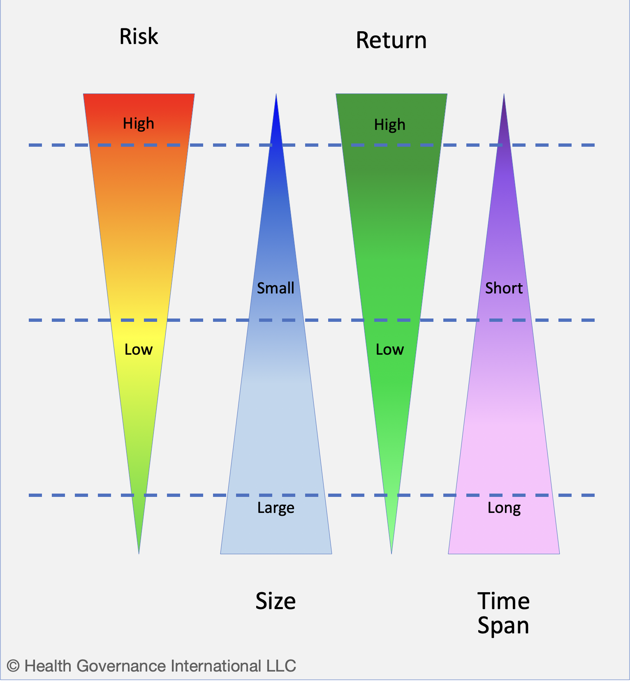
Governance-related risks in pharmaceutical supply chain
An investor’s perspective

Slide 3
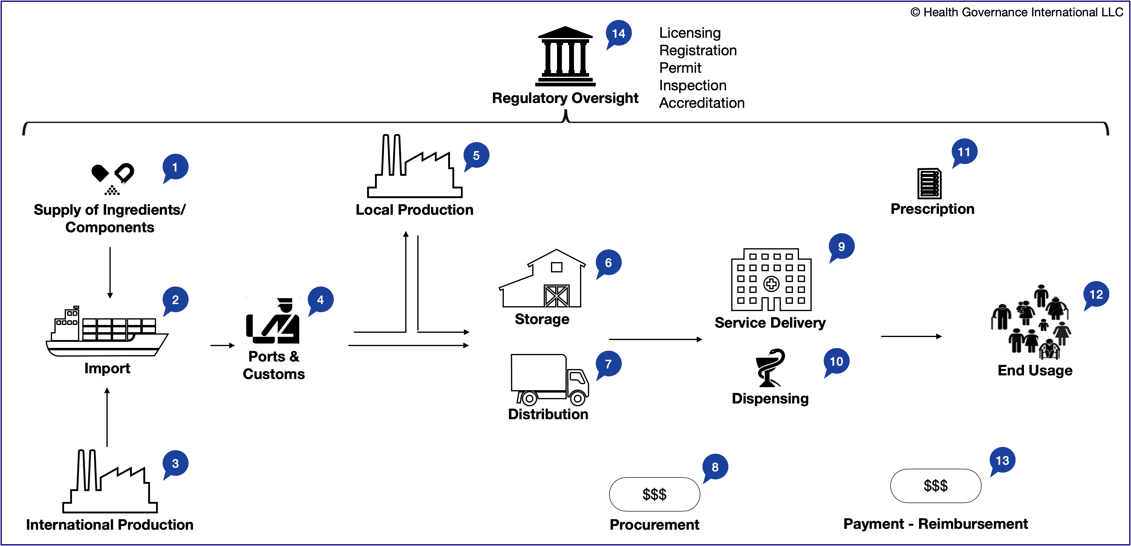
Governance-related risks in pharmaceutical supply chain
Risks are across 14 main functions

Slide 4
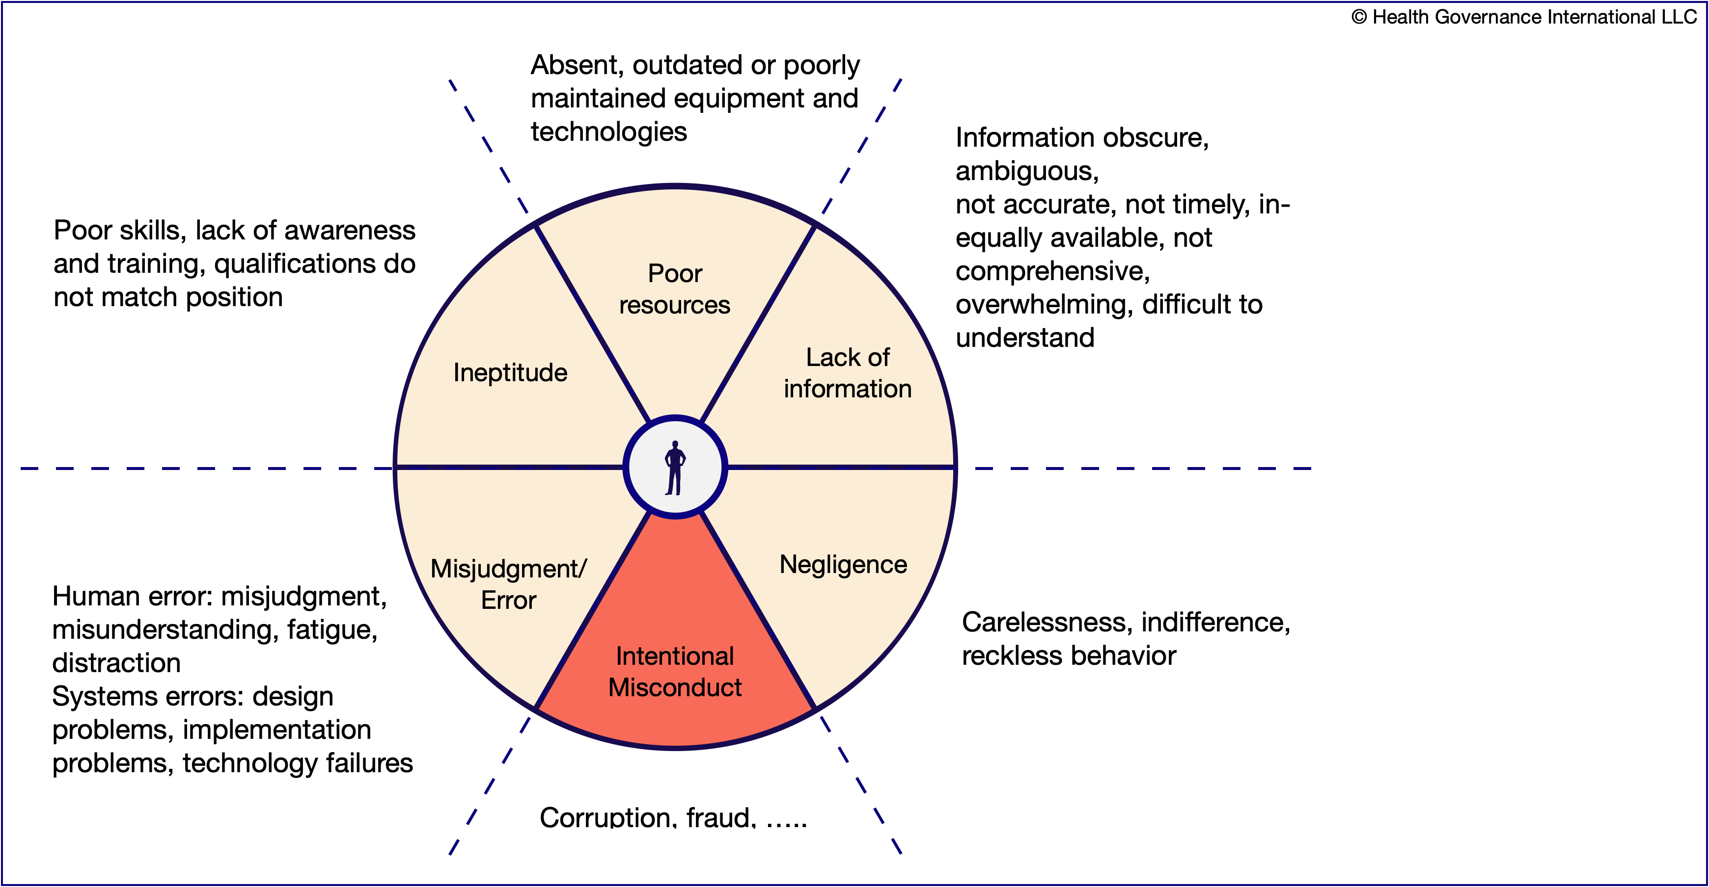
Governance-related risks in pharmaceutical supply chain
Why actors fail to realize value?

Slide 5
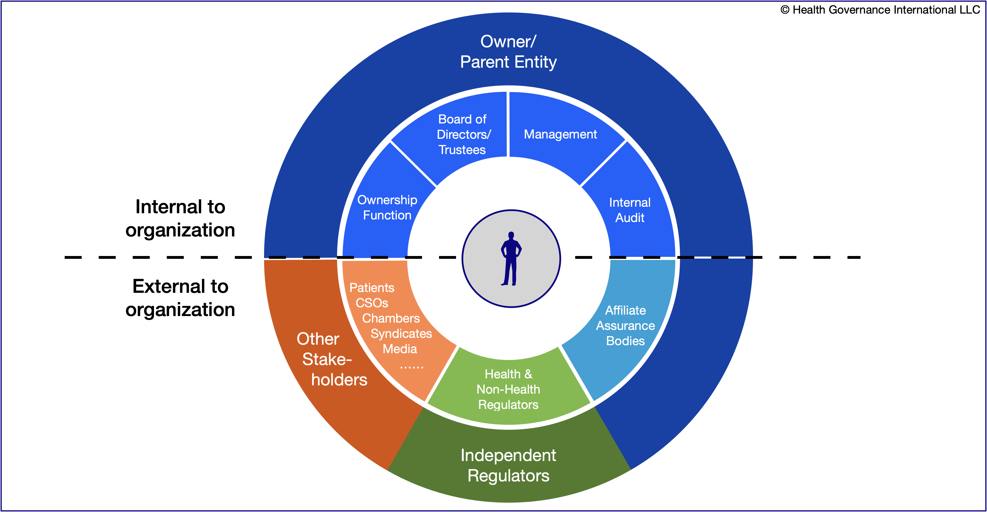
Governance-related risks in pharmaceutical supply chain
Reducing the risk - HGI 360º Accountability©

