Slide 1









Consultancy
Providing market intelligence
and support clients in developing entry and growth
strategies for Africa.
Advisory
Catalyzing for change,
assisting partners to improve
performance and achieve health outcomes.
Investments
Identifying opportunities for
sustainable investments to grow the business of healthcare.
Dr. Amit N. Thakker
Chairman, Africa Health Business
+254 704 835 926
info@ahb.co.ke
Rhaphta Road,
Westlands, Nairobi-Kenya
www.ahb.co.ke
Africa Health Business
@AfricaHealthBiz

Slide 2

Who is the private sector in health?
Informal, untrained providers
TBA’s, healers,
drug shops, "quacks"
Formal providers
Professional healthcare workers
Facilities
Clinics,
Hospitals, diagnostic centers and academia
Pharma industry
Manufacturers, distributers, wholesalers
retailers
Commercial industry
In-house clinics /facilities, employee care
Health Financing
Medical insurance, health savings, microfinance, OBA
Support Services
Non-clinical services
(PR, research, ICT, medical gasses, training)

Slide 3
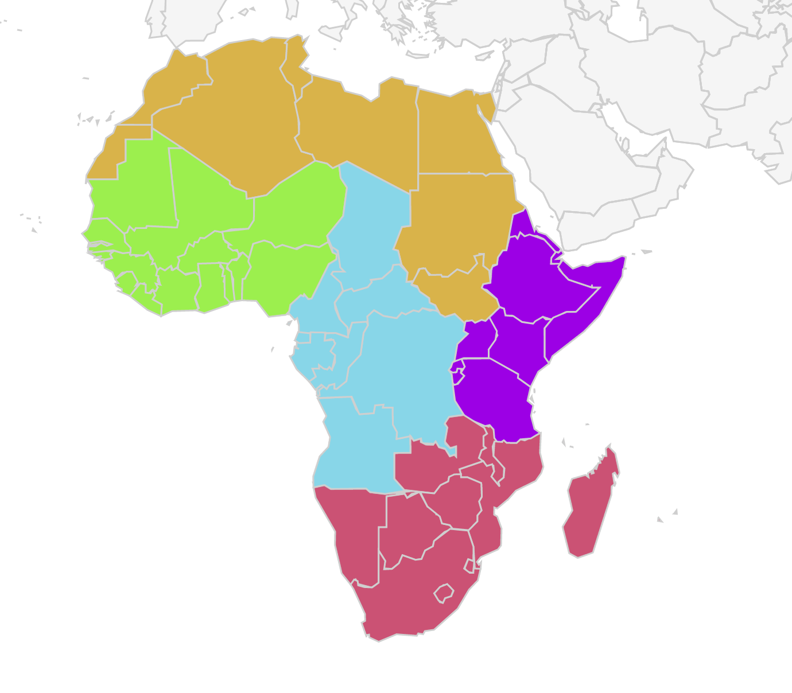
Size of the private healthcare sector
Over 50% of Africa's services are delivered by private facilities
Over 90% of the health products are supplied by private organizations
SME’s play a critical role in the private health sector ecosystem
“If we can get all the critical players – governments, donors, investors, and providers – to leverage the private health sector and integrate it effectively with public systems, we can also greatly improve the quality of care”
- Lars Thunell, IFC Executive Vice President and CEO

Slide 4

How to leverage the strengths of the private health sector
Governance
PPP’s– Africa Healthcare Federation – Africa CDC/African Union
Information
Media - public awareness - community engagement - knowledge & best practice sharing
Human resources
Laboratory personnel – frontline healthcare workers – healthcare managers –
Financing
Resource mobilization – private insurance – blended finance - loans and cash advances
Service delivery
critical care provision – maintaining healthcare treatment – supply chain
Technologies
ICT tools –
identification vulnerable populations - telemedicine - predictive analysis

Slide 5
How can the private sector be best supported to respond to the pandemic?
Get organized
Private sector to be mainstreamed by MOH and Africa CDC in their taskforces
Marshall space
Engage infrastructure experts and architects to promote private sector facilities to be COVID-19 ready
Activate staff
Motivate, protect & remunerate healthcare workers to maintain their jobs and perform duties uninterrupted + healthcare worker welfare package
Ensure supplies
Quick responsive government procurement to ensure affordable, qualitative & timely supplies coming to the countries + encourage local manufacturing
Create systems
Support from development partners (e.g. BMGF) and knowledge institutions (e.g. BCG) to assist private and public sectors to better coordinate joint actions
Get resources
Create awareness of national funds e.g. Africa COVID Response Fund, that are credible and transparent + promote private sector resource centers in country
ICT & mobile heath
Robust and responsive regulatory landscape to foster mobile health and ICT innovations to track, trace and treat
Notes:
Government procurement: issuing letters of credit or local purchase orders

Slide 6


THANK YOU
CONSULTANCY | ADVISORY | INVESTMENTS

