Slide 1
CACOVID
PRESENTATION
April 2020

Slide 2


MISSION
Supporting Government’s effort in the fight against the unfolding Covid-19 crisis in Nigeria
March 2020

Slide 3

WHAT IS COVID?
The Coalition Against COVID-19 (CACOVID), is an effort spearheaded by Aliko Dangote, Herbert Wigwe and other private sector leaders together with the Central Bank of Nigeria, to support the Nigerian Government's efforts to combat the unfolding Covid-19 crisis.
Due to the speed at which the virus is spreading, it is important to proceed immediately. Some modelling suggests that in another 2-3 weeks, a large spike in cases - as high as 1 million cases could be our reality if nothing is done. It is important we prepare for the worst while we hope for the best.
Our goal is to have as many organizations (companies, philanthropies, donors) join this effort to effectively complement Government’s efforts to combat Covid-19

Slide 4
OBJECTIVES OF CACOVID
Mobilize private sector thought leadership
Mobilize private sector resources
Increase general public awareness, education and buy-in
Provide direct support to private and public healthcare’s ability to respond to the crisis
Work in collaboration with Government

Slide 5
STRATEGIC OBJECTIVES OF RESPONSE
Screening at POEs
Rapid access to diagnosis
Trained and sufficient human resource
PREPARING NIGERIA FOR COVID-19
Early detection, confirmation of cases and contact tracing
Equipped treatment centres in priority states
Sufficient and trained human resource
Medical countermeasures
Develop and maintain capacity to effectively manage cases
Coordination structure established by NCDC
24/7 connect centre for the public
Dissemination of guidelines
Regular communication with public
Coordination and communication with Nigerians
* This is the NCDC Response plan – we are basing the CACOVID intervention on this expressed strategy

Slide 6
POTENTIAL NO-REGRETS MOVES FOR COUNTRIES
Disease control
Non-Pharmaceutical Interventions (NPIs)
Supporting Society
Pharmaceutical Interventions
Health care infection prevention and control
Everyday personal NPIs
Address ongoing health care needs
  Isolation and treatment centers
  To the extent that the equipment is available, hospitals and other health care facilities should wear protective equipment and take prevention and control measures when caring for suspected or confirmed cases of COVID-19
  Relatively low cost and high impact to encourage individuals to wash hands, cover coughs, and stay home if sick
  In all scenarios, should address issues in supply chain (e.g. secure masks and protective equipment) and continue to address ongoing health needs of the community (e.g. through increased telemedicine if available , innovative ways?)
No approved products (treatment or vaccines) for use exist yet
Environmental NPIs
  Should also encourage individuals to clean surfaces, increase ventilation whenever possible
However tests suggest Chloroquine and azythromycine might be helpful
Protect vulnerable populations
  In all scenarios, should protect vulnerable populations as it reduces COVID-19 related deaths, minimizes economic disruptions by ensuring healthier and more stable workforce, and efficiently uses medical resources
Community engagement
  Clear communication and community engagement essential to enable success of all other levers especially measures that are establishing social distancing.
CACOVID focus
© 2018 Bill & Melinda Gates Foundation |

Slide 7
PROPOSED IMMEDIATE INTERVENTIONS
Procure NCDC/WHO approved diagnosis protocols to enable testing across our 36 States and FCT. This will be done by expanding the current molecular laboratories in Nigeria – and providing testing supplies for the existing available platforms (Roche Cobus and Cepheid Gene Expert )
Set up isolation/treatment centers – a combination of tents (A/C, beds, toilets, and other support infrastructure) and existing buildings that can handle over 1,000 patients
Provide palliatives to 1.7 million households across the Nigeria –basket includes Rice, Garri/Maize flour, Pasta, Noodles, Sugar and Salt

Slide 8
Amount Raised
NGN 21,588,500,000
by 50 donors
* As of April 6

Slide 9
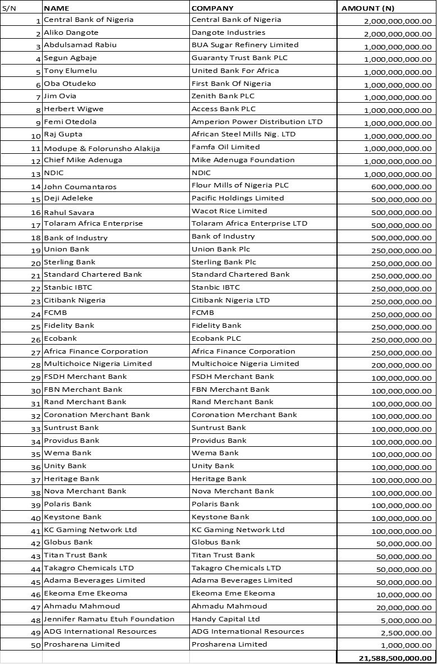
Donors

Slide 10
STRUCTURE

Slide 11
PROPOSED STRUCTURE TO DELIVER
The Supervisory team provides leadership of COCAVID
The Funding Committee provides initial funding for the work, and leads fundraising
  Execution Team – CACOVID Secretariat – oversees the following
  Technical Committee provides intellectual, technical and medical expertise
  Operations Committee provides delivery, logistics, procurement
  Communications Committee provides advocacy and communications

Slide 12
PROPOSED STRUCTURE TO DELIVER
Supervisory Team
Goodwin E., Aliko D., Herbert W.,Akin. A, Jim O., Christian H., Zouera Y., Osayi A .
Administrator
Zouera Y.
Support
Amaechi O.
Technical Committee
NCDC
Operations Committee
PMO (Zakari M.)
Advocacy/Comms
Amaechi O. + Tony C.
Support
Osayi A.

Slide 13
FUNDING TEAM
The funding team will be responsible for the initial funding of this effort.
They will also be responsible for additional fundraising.
Members of this team include among others:
Godwin Emefiele
Aliko Dangote
Herbert Wigwe
Jim Ovia
Tony Elumelu
Segun Agbaje
Abdulsamad Rabiu
Femi Otedola
Adesola Adedotun

Slide 14
TECHNICAL TEAM
The technical team is in charge of the intellectual leadership and guidance around the following:
  Testing issues, challenges, procurement;
  Treatment protocols;
  Isolation centers, ICUs,
  Training, Protection gear for medical and health workers,
  Disinfection of public spaces,
  Liaison with Abuja
Members of this team include:
  Dr. Chikwe Ihekweazu (NCDC)
  Prof. Akin Abayomi (Lagos State Commissioner for Health),
  Dr Sani Aliyu (Presidential Taskforce COVID
  Dhamari Naidoo (WHO),
  Dr Christian Happi, (renowned microbiologist - who sequenced the Covid-19 genome in Nigeria),
  Dr. Phillip Onyebujoh, (Infectious disease specialist),
  Dr. Paulin Basinga (Bill and Melinda Gates Foundation),
  Dr Yemi Johnson (First Cardiology Consultants)
  Zouera Youssoufou (Aliko Dangote Foundation),
  Omobolanle Victor-Laniyan (Access Bank)

Slide 15
OPERATIONS TEAM
The operations team will be responsible for:
  Project management and Delivery oversight
  Logistics
  Human Resource Recruitment for the Isolation centers and labs
Members of this team include among others:
CBN, Access Bank, Aliko Dangote Foundation, Dangote Industries, MTN, Nigerian Breweries, Zenith Bank, GTB, Union Bank, Stanbic, Ecobank, Fidelity, ACT Foundation, Channels TV, BUA group, First Bank

Slide 16

CACOVID
PRESENTATION TEMPLATE
2020
THANK YOU

