Slide 1
v
IFC's Engagement in the Health Sector in Africa – Focus Pharma Value Chain

Slide 2
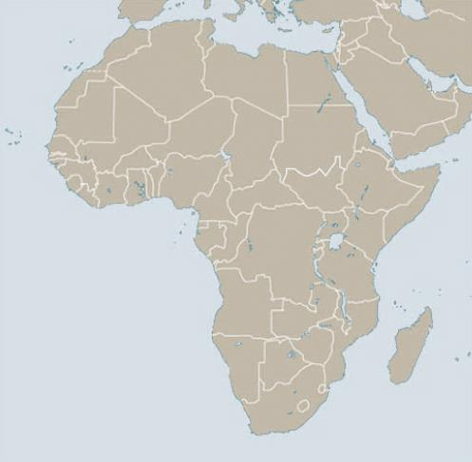
IFC - Unmatched Local Presence in Africa
50+ years of investing in Africa
Financial Structuring & Industry Knowledge
Global & Local Knowledge
Leveraging WBG Products
Environmental, Social and Governance
Advice
Equity and Debt Financing in hard and local currency
Extensive relationships with key strategic players
Strong relations with Governments and Public Entities
Advice on ESG best practices
Advisory programs, including local supplier development, corporate governance, community development
In-house technical, market and regulatory expertise
Ability to participate at all levels of the capital structure
20+ local offices and more than 180 professionals
Able to draw on EM best practices from global portfolio
MIGA & PRG insurance products
Special initiatives, e.g. MCPP, Scaling Solar Power, SME Ventures Initiative
Local consultation and disclosure
Best in class on ESG standards
SME capacity building
Algiers
Tunis
Rabat
Mediterranean
Sea
Beirut
Jerusalem
Amman
Cairo
Dubai
Red Sea
Dakar
Bamako
Sana’a
Ouagadougou
Freetown
Abuja
Addis Ababa
Monrovia
Abidjan
Lagos
Juba
Accra
Douala
Bangui
Nairobi
INDIAN
OCEAN
Kinshasa
Bujumbura
Kigali
Dar es-Salaam
ATLANTIC
OCEAN
Lusaka
Antananarivo
IFC Hub Offices
IFC Country Offices
Johannesburg
Maputo
2

Slide 3
Health Infrastructure¹ Bubble Size = GDP per Capita (in millions)
In almost all emerging markets regions health infrastructure is
still lacking compared to the
WHO recommendations,
for many of these regions this
is for both capital and human resources.
WHO Recommendation
The Affordable Healthcare Value Chain
Out of Pocket Expenditure³ | % of Total Current Expenditure
In low-income countries,
families must pay the highest share of healthcare costs.
Low
income:
43.4%
Upper Middle Income:
32.9%
In 2018
In 2018
Many developing countries suffer from poor access to affordable quality healthcare
Health Access and Quality Indicator² Index (0=low to 100=high) 1990-2015
Once families in emerging markets seek out care, it is still substandard compared to those
in high income countries.
3
Source: ¹ World Bank WDI Database (2020); ² The Lancet Healthcare and Quality Index (2015), based on the Global Burden of Disease Study; ³ World Bank WDI Database (2020); ⁴ World Bank WDI Database (2020)

Slide 4
Healthcare Investment Strategy
Objective: Expand access to affordable, quality health products and services
To achieve this, we have developed a portfolio-approach that incorporates…
1
2
3
Health Service Providers
Pharmaceuticals
Medical Technologies
Scalable Healthcare Providers including integrated service providers, hospital groups/clinic chains, specialty care chains, and diagnostics/lab groups
“Centers of excellence”/ stand-alone facilities in more immature healthcare markets*
Investments in PPPs and contracting entities to enhance public sector with private industry participants
Regional generics manufacturers to support the development of pharmaceutical hubs in key development markets
Support Biopharma, API intermediates and local vaccine manufacturers and partner with sizeable PE fund managers
Pharmaceutical Distribution and Retail including supply chain logistics as well as digital and omni-channel pharmaceutical retailers.
Medical devices and equipment manufacturers of products appropriate for developing market conditions
Distribution networks for high quality medical equipment
Digital Health (Services and Technology Support)
4
Across the Health Spectrum
*Mainly IDA countries and on a very selective basis

Slide 5
COVID-19 Challenges and Opportunities
Cost management has been an imperative / Cost reduction / Headcount reduction
Supply chain disruption continues as a major issue to providers
Governments hesitant to work with the private sector; highlighted poor health system coordination
COVID-19 care does NOT cover the loss of revenue from other care
Concern Short-term knee-jerk vs long term business continuity
Backlog for elective and non-elective care
CAPEX plans delayed
Majority of private players did have minimum of 2-month major hit on revenues (up to 70% reduction).
Price gouging in some markets
Concerns of quality and counterfeiting on the rise as pharmaceutical supply chains have been squeezed
Lack of recognition of long-lead times to increase production for key devices
Opportunity to streamline regulatory approval processes for innovative medicines and therapies
Increased focus on quality, patient safety
Rethinking of infrastructure design and modular construction to facilitate quick and timely reconfiguration as the need for isolation rooms, ICUs changes
Process improvements and workflow optimization to align with enhanced quality and patient safety needs
Government oversight increase
Increased public private collaboration opportunities
Increased use of digital health/ telemedicine
Consolidation opportunities through immediate M&A
Regionalization and localization of production of essential medical equipment to create more robust supply chains
Medical equipment and key pharmaceutical products are beginning to be considered essential items for national security and welfare globally
Healthcare operators with diversified revenue channels and patient flow channels seem to deal with the crisis better than single facility providers
5

